Slide 1
2018 QUANTITATIVE STRATEGY CASE INTERVIEW
By: Traci Lim

Slide 2
Datasets Used
HDB Resale Flat Transactions from year 1990 to 2018
HDB Addresses with Geographical Coordinates
HDB Addresses with Geographical Coordinates
School Addresses and MRT data with Geographical Coordinates
Certificate of Entitlement (COE) Bidding Results

Slide 3
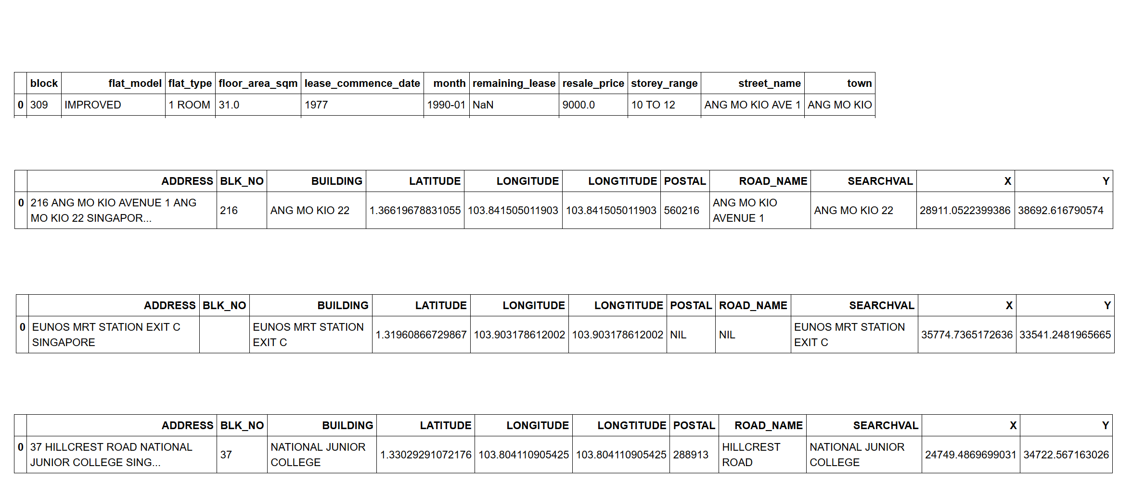
A Peek

Slide 4
Q1: Data Viz
Question 1A:
Show an overview of the number of property transactions, median price across the years.
Provide both a view at the national level, as well as by HDB towns.
Your dashboard should also provide functionality to filter based on Flat Type (e.g. look at only 5 Room flats).

Slide 5
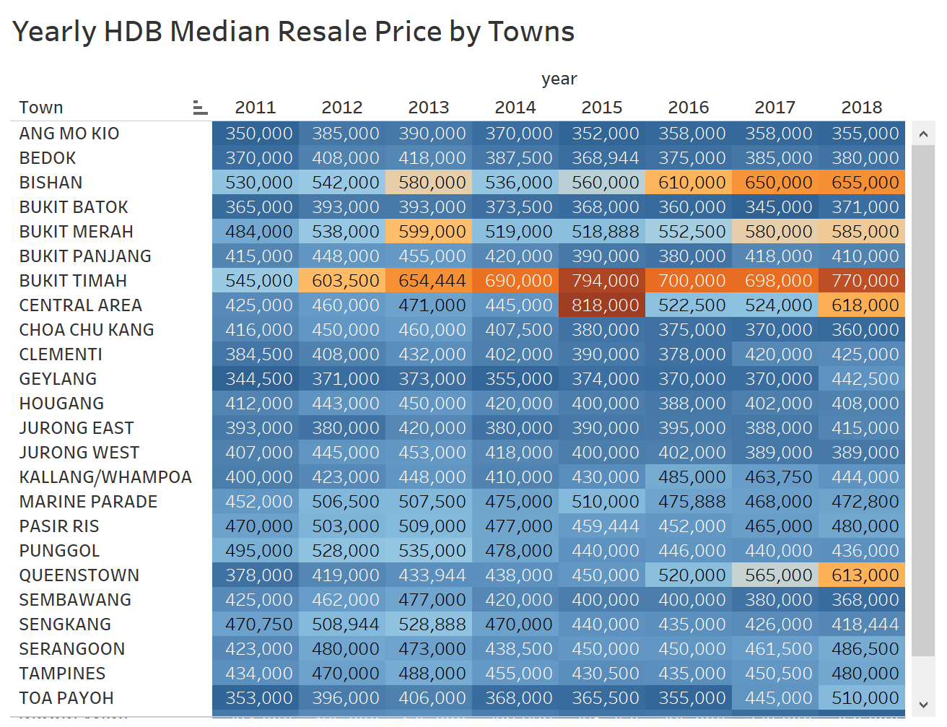
Trends on HDB Resale Prices
Consistently high prices for flats in Bishan and Bukit Timah.
Approx. 2x Jump!

Slide 6
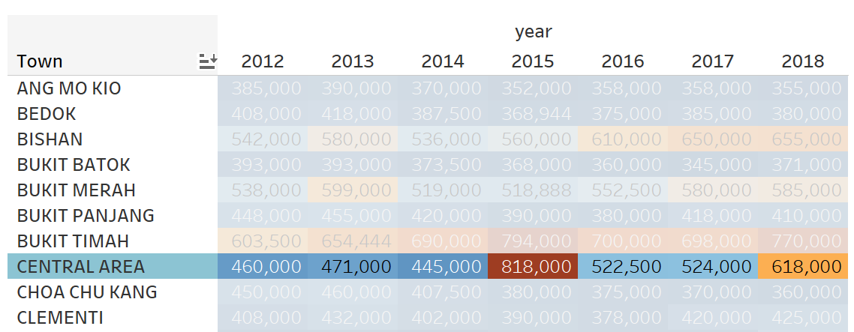
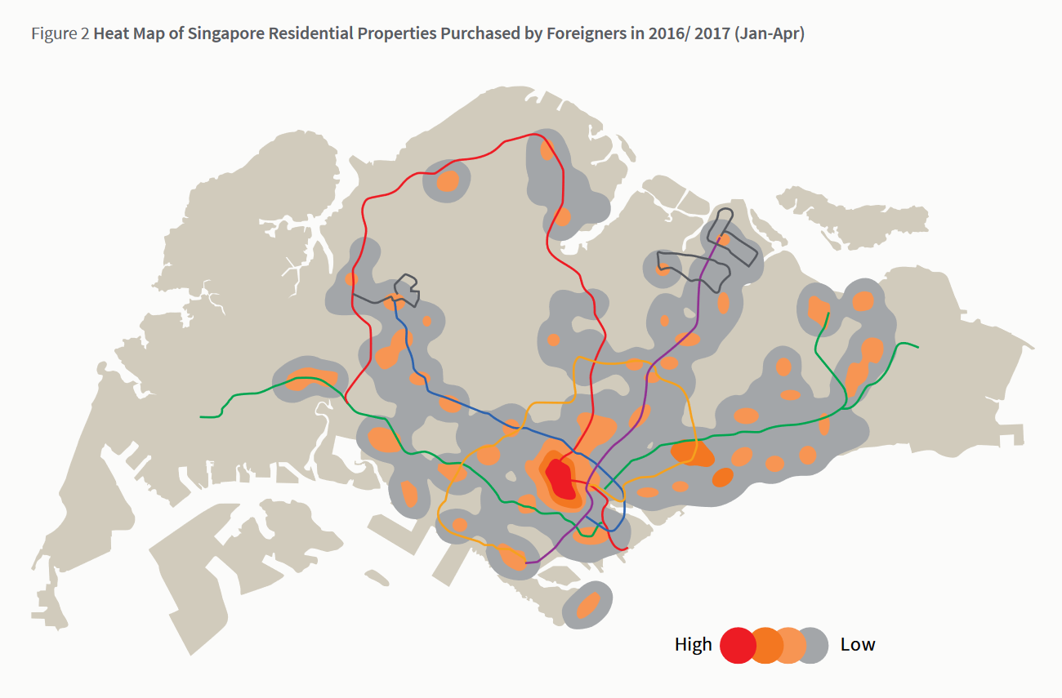
Why 2x Jump?
Report from JLL shows out of 1610 purchases made by foreigners in 2016/2017, 60% were located in Central Area
But foreigners can’t buy HDBs
Could be due to a trickle-down effect
http://www.ap.jll.com/asia-pacific/en-gb/Research/SG-hotspots.pdf?587a0557-2140-49bc-b82c-46b7d96b1df2

Slide 7
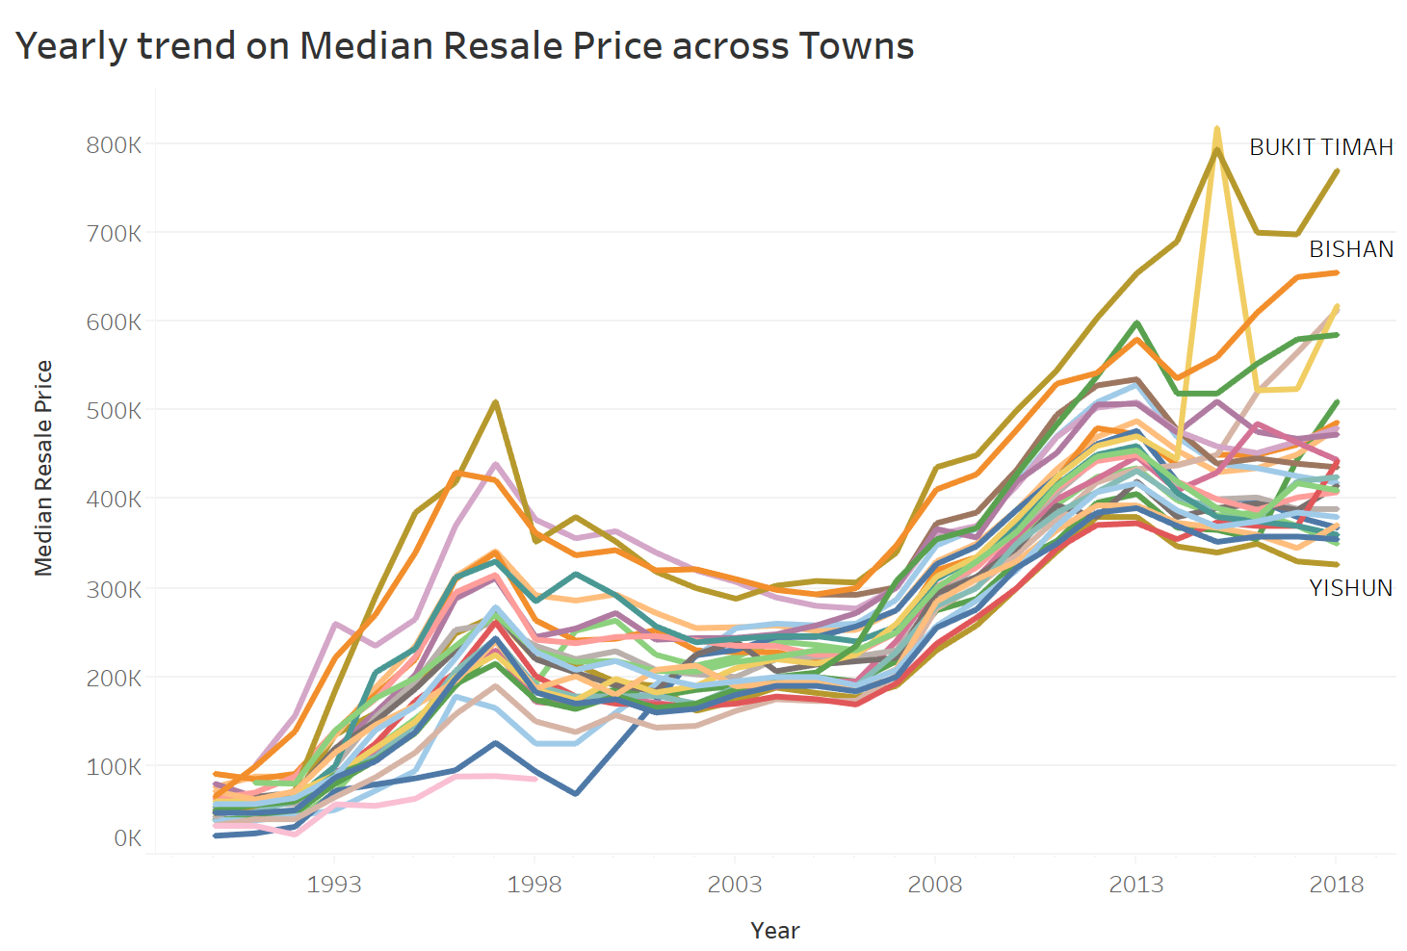
Yearly Trend
2013-2014 Reversal in trend
Central Area

Slide 8
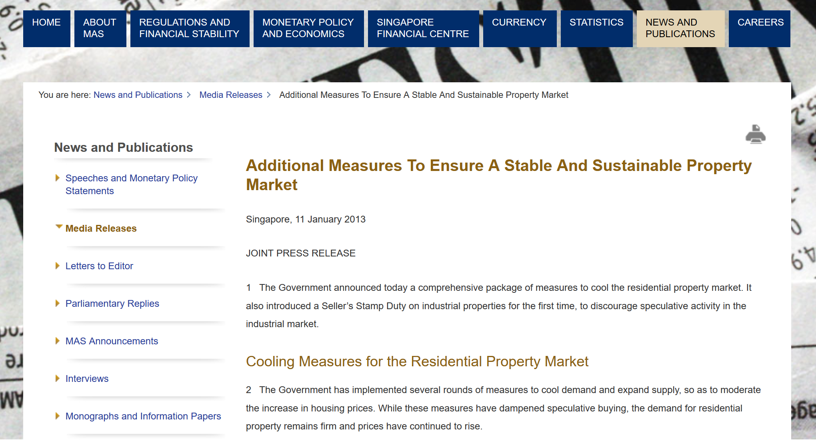
Reversal in trend from 2013 to 2014
http://www.mas.gov.sg/News-and-Publications/Media-Releases/2013/Additional-Measures-To-Ensure-A-Stable-And-Sustainable-Property-Market.aspx

Slide 9
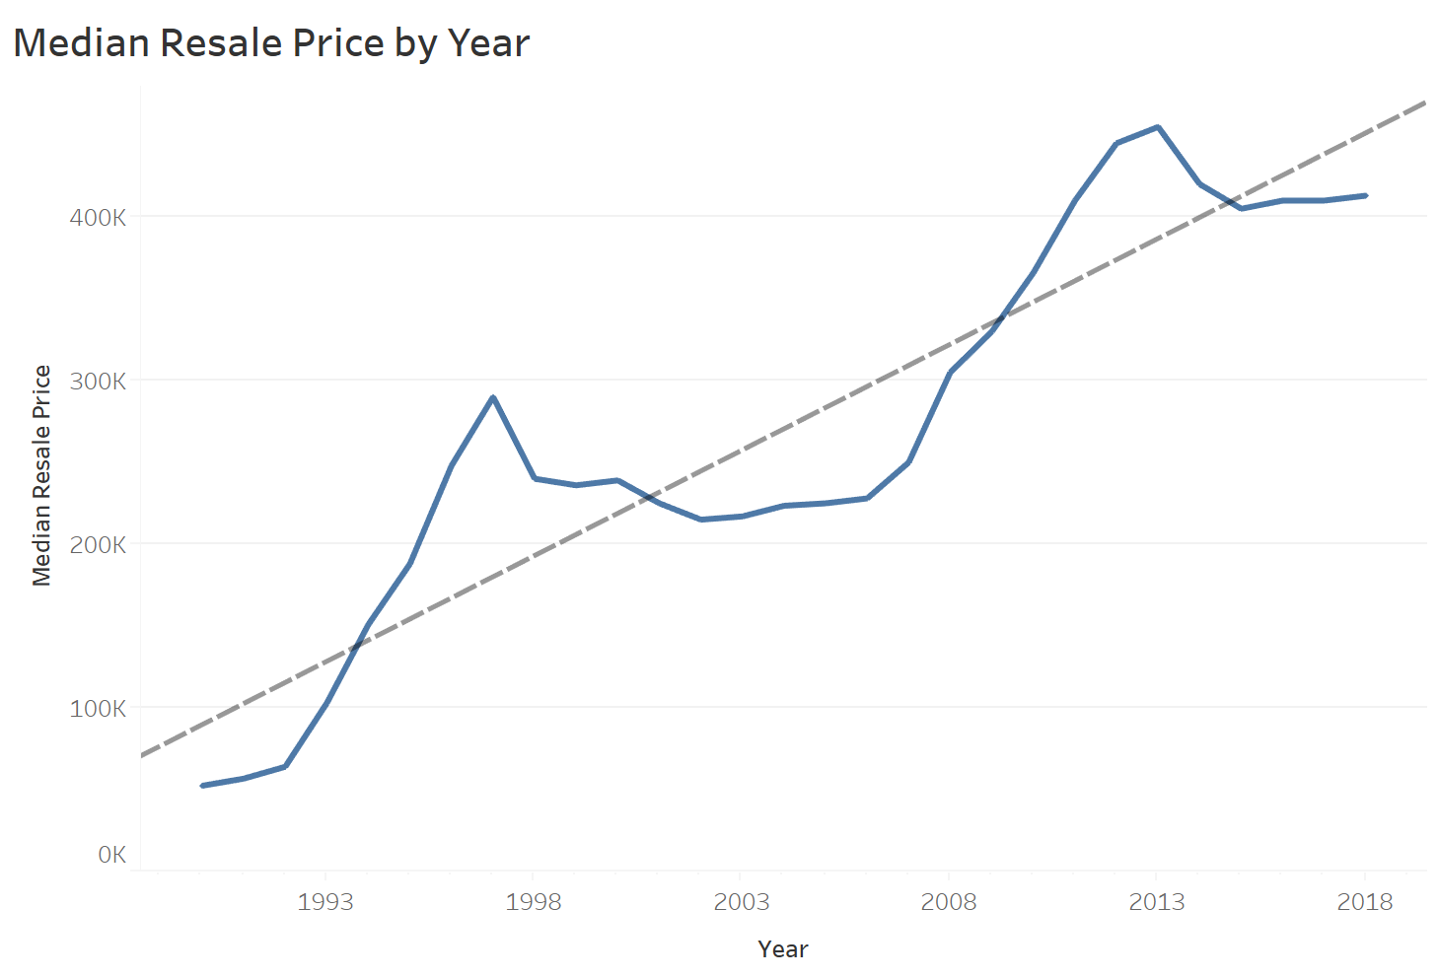
Up and Up and Up
Although prices are not adjusted by inflation, median resale prices have increased by a factor of 4 since 1990.

Slide 10
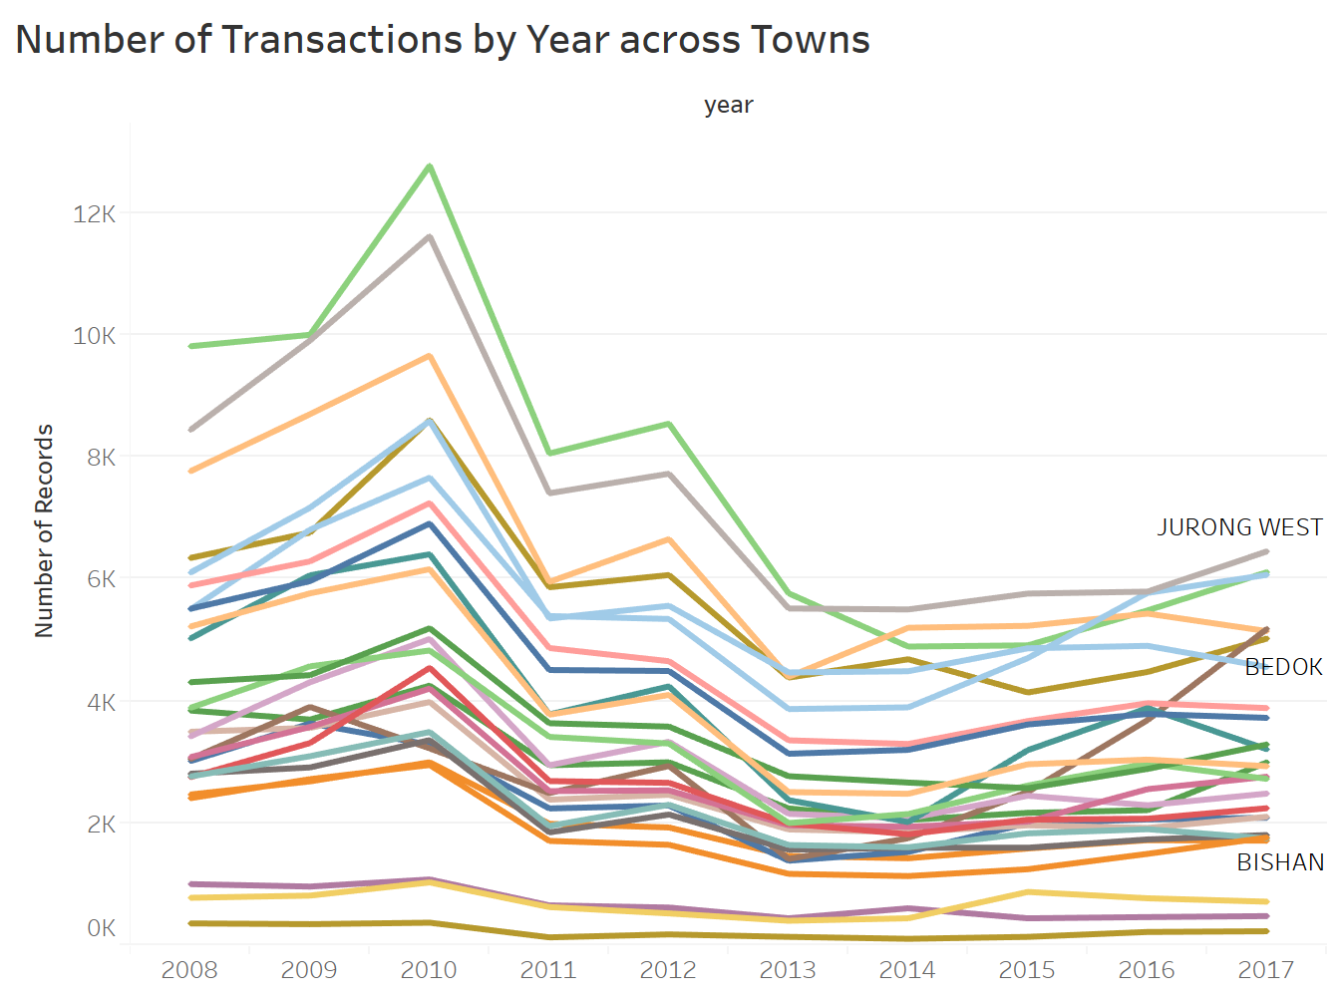
First wave of cooling measures amidst an overheated market
In January 2011, four Singapore property cooling measures were introduced.
https://www.sgpropertyreviews.com/guides/new-rules-for-buying-property-in-singapore/

Slide 11
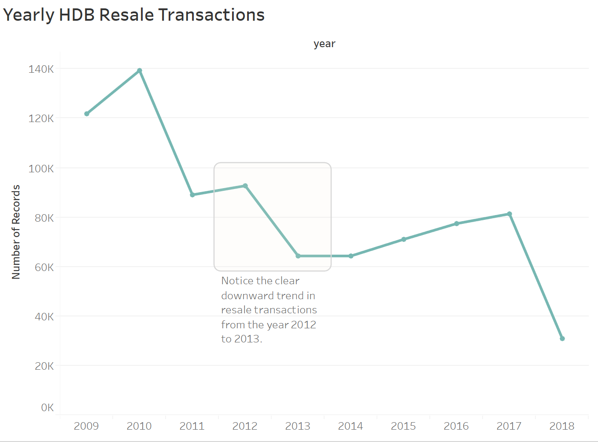
More cooling measures?

Slide 12
Q1: Data Viz
Question 1B**:
Some buyers would want to get the largest flat possible within a given budget.
Create a dashboard to allow potential buyers to input their budget, and then suggest towns where such flats exist based on historical transactions.
Question 1C***:
There are buyers who would like to optimise given the proximity of a flat to important locations in the neighbourhood, such as the nearest MRT station.
Create a dashboard that allows buyers to: i) input their budget; and ii) optimise flat selection given distance to important locations around the neighbourhood.

Slide 13
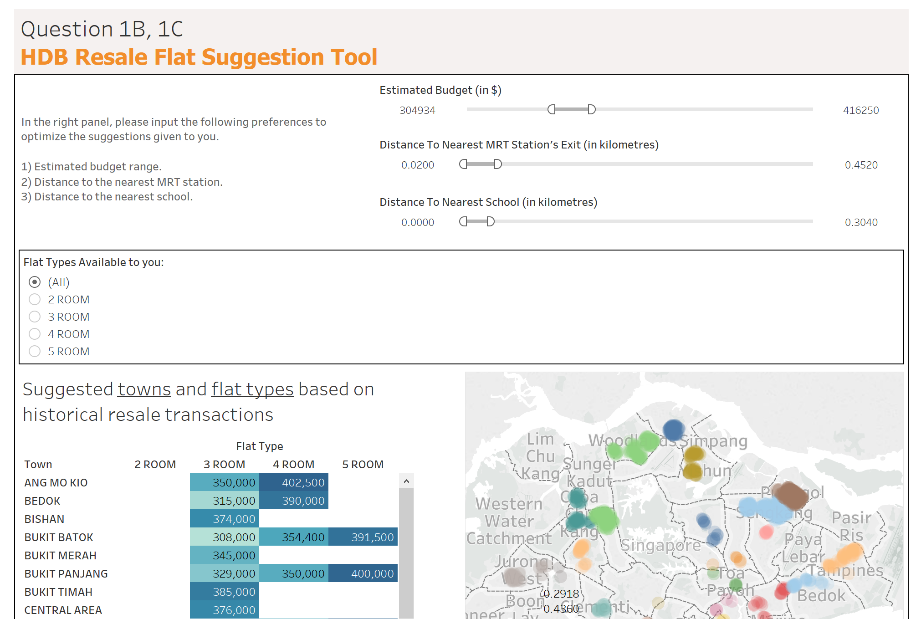

Slide 14
Q2: Data Modeling
HDB wants to know if a resale flat transaction fits market expectations. Your task is to create statistical models to answer the following questions.
Question 2A*: Predict a resale flat price’s transaction price in 2014. Use the following characteristics: flat type, flat age and town. Propose and implement a minimum of three models, select the best model, and explain the reasons for your choice.

Slide 15
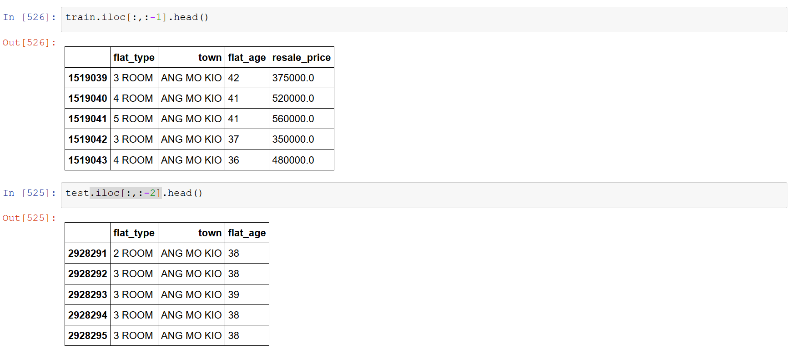
Predicting Resale Price with 3 Features

Slide 16
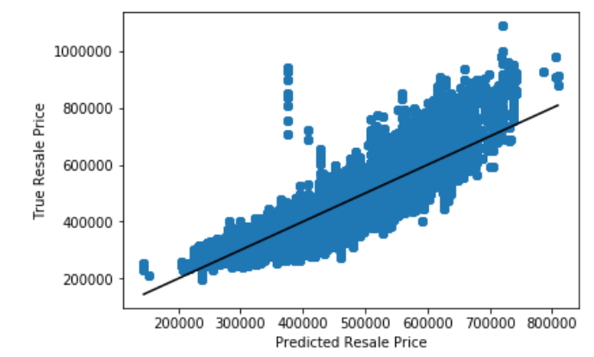
Models used
Linear Regression with Regularization (Elastic Net)
Simple
Easy to understand
Decision Trees (Regression)
Simple
Good when there are lots of categorical variables
Can capture non-linear relationships
LightGBM (Microsoft’s Gradient Boosting Algorithm)
Fast
Cutting Edge
Mega-improved version of decision trees

Slide 17
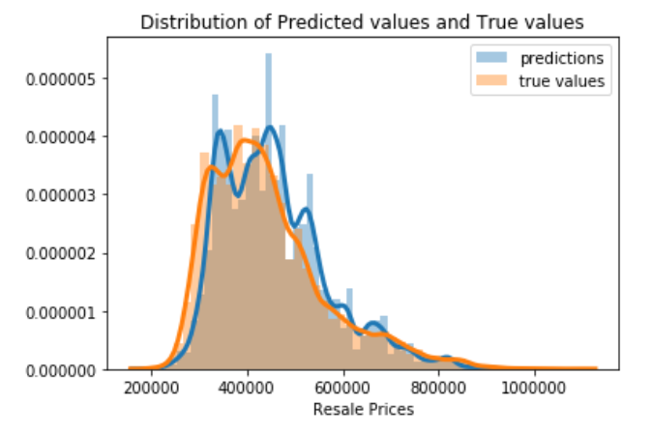
What is LightGBM?
LightGBM (Microsoft’s Gradient Boosting Algorithm)
Fast (took 3 seconds)
Cutting Edge
Mega-improved version of decision trees

Slide 18
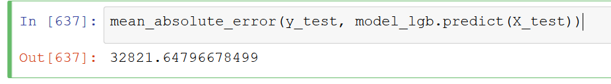
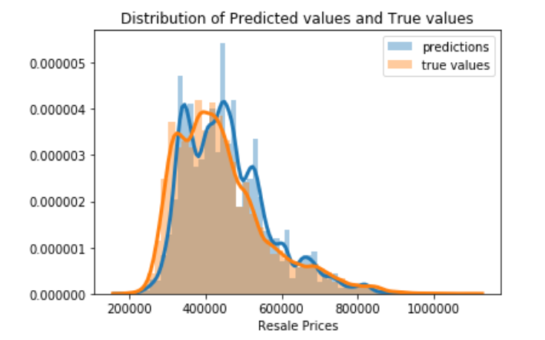
Every prediction is $33,000 off on average
This is one of the cases where Tree models > Linear models.
MAE tells us how big of an error we can expect from the predicted value on average.

Slide 19
Kena Scam?
Question 2B**: A flat was sold in Nov 2017 with the following characteristics:
Flat type: 4 ROOM
Town: Yishun
Flat Model: New Generation
Storey Range: 10 to 12
Floor Area (sqm): 91
Lease Commence Date: 1984
Resale Price: 550,800
Was this a reasonable price for the transaction? How confident are you in your assessment?

Slide 20
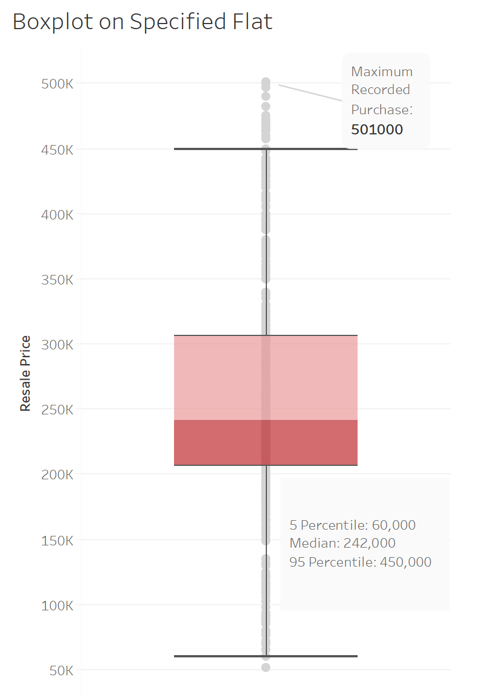
Highly overpriced transaction
The word ‘reasonable’ is highly subjective, since the transaction consists of a willing buyer and seller
Must be good fengshui

Slide 21
Predicting Flat Types
Question 2C***: Someone mistakenly deleted the column containing data on Flat Type in the database from 2015 onwards. While backups exist, these data are critical to HDB’s daily operations, and time would be needed to restore these data from the backup. Senior management would like you to create a model to predict flat type given a transaction’s other characteristics. Explain the reasons for choosing this model.

Slide 22
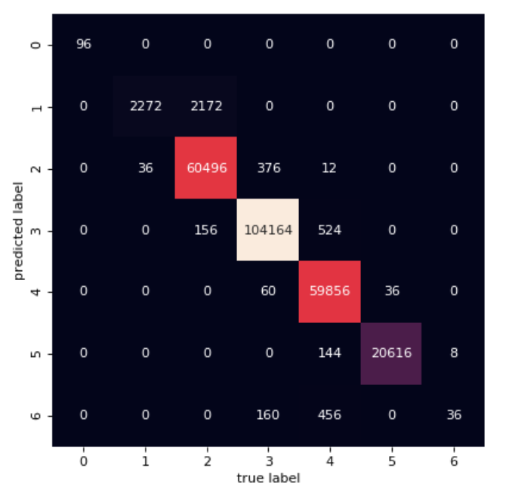
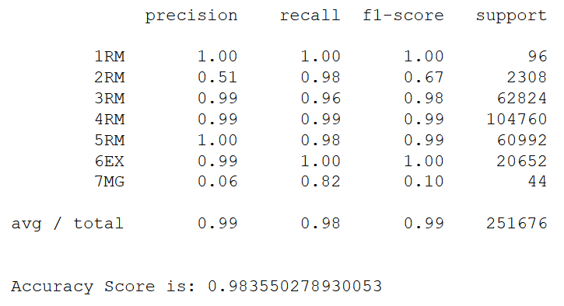
Model correctly predicts flat type 98% of the time
Confusion Matrix

Slide 23
Q3: Policy Analysis
Question 3A*:
Yishun has received a negative reputation as “Crazy Town”, and property prices might have been impacted. Are Yishun flats the cheapest in the country?

Slide 24
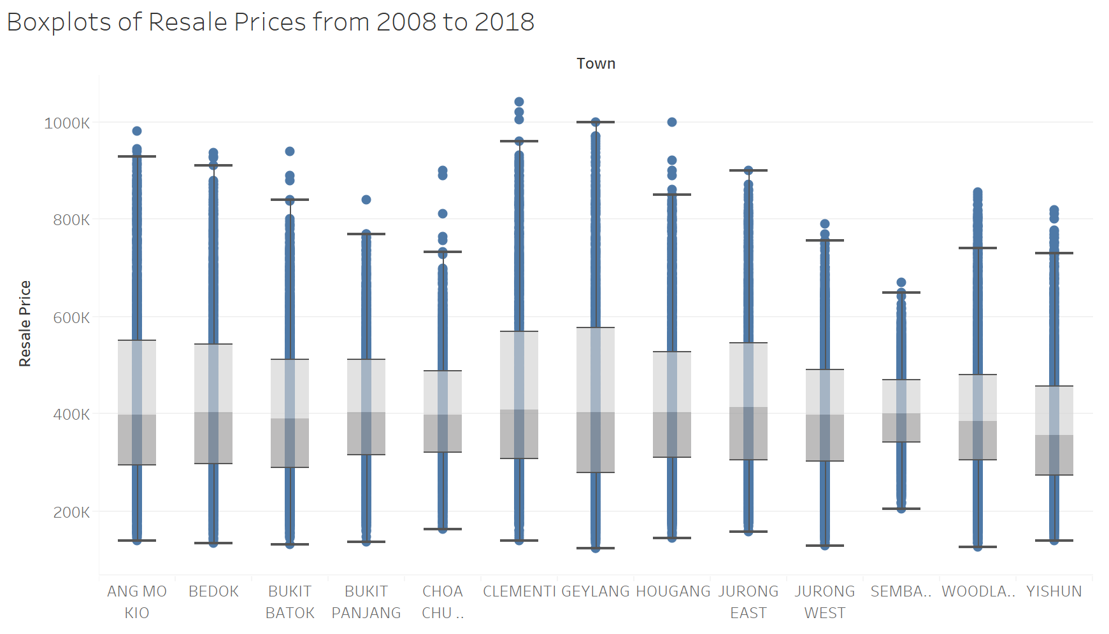
Can’t Beat Yishun Cheap Prices

Slide 25
Q3: Policy Analysis
Question 3B*:
Some members of public have been saying that flat sizes have gotten smaller over the years. Is there any truth in this statement?

Slide 26
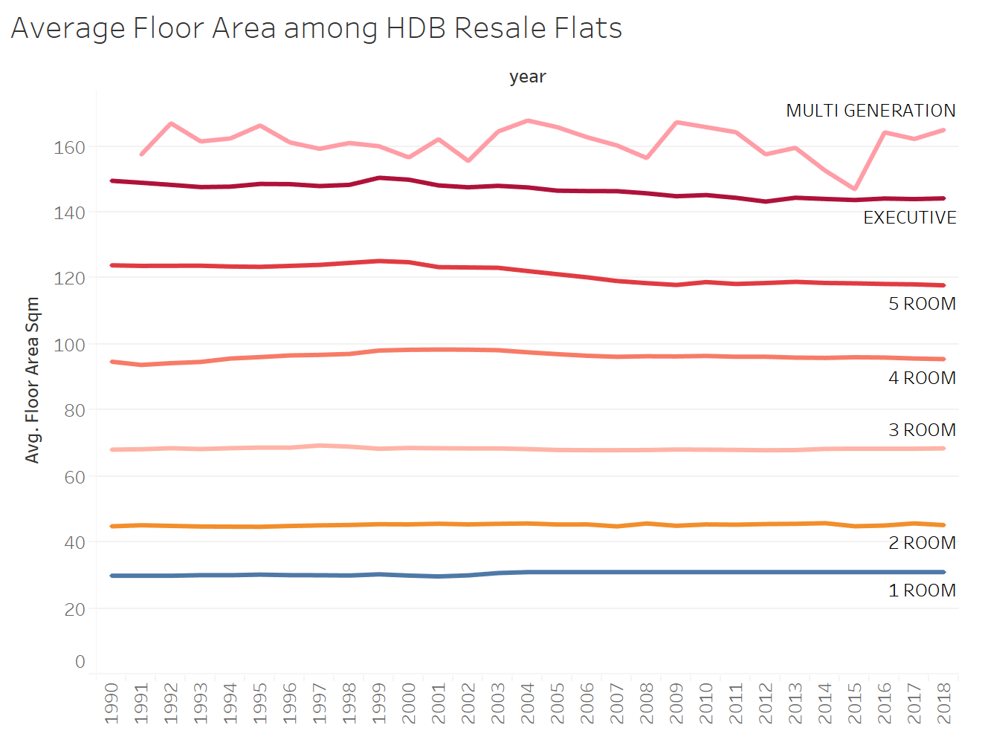
Nearly Parallel lines
Constant trend

Slide 27
Q3: Policy Analysis
Question 3D***:
There have been comments online that people are buying flats in towns further from the city so that the cost savings can be used for a car.
Are resale prices in HDB estates in areas further away from the city (i.e. Sengkang and Punggol) impacted by Certificate of Entitlement (COE) prices for cars?

Slide 28
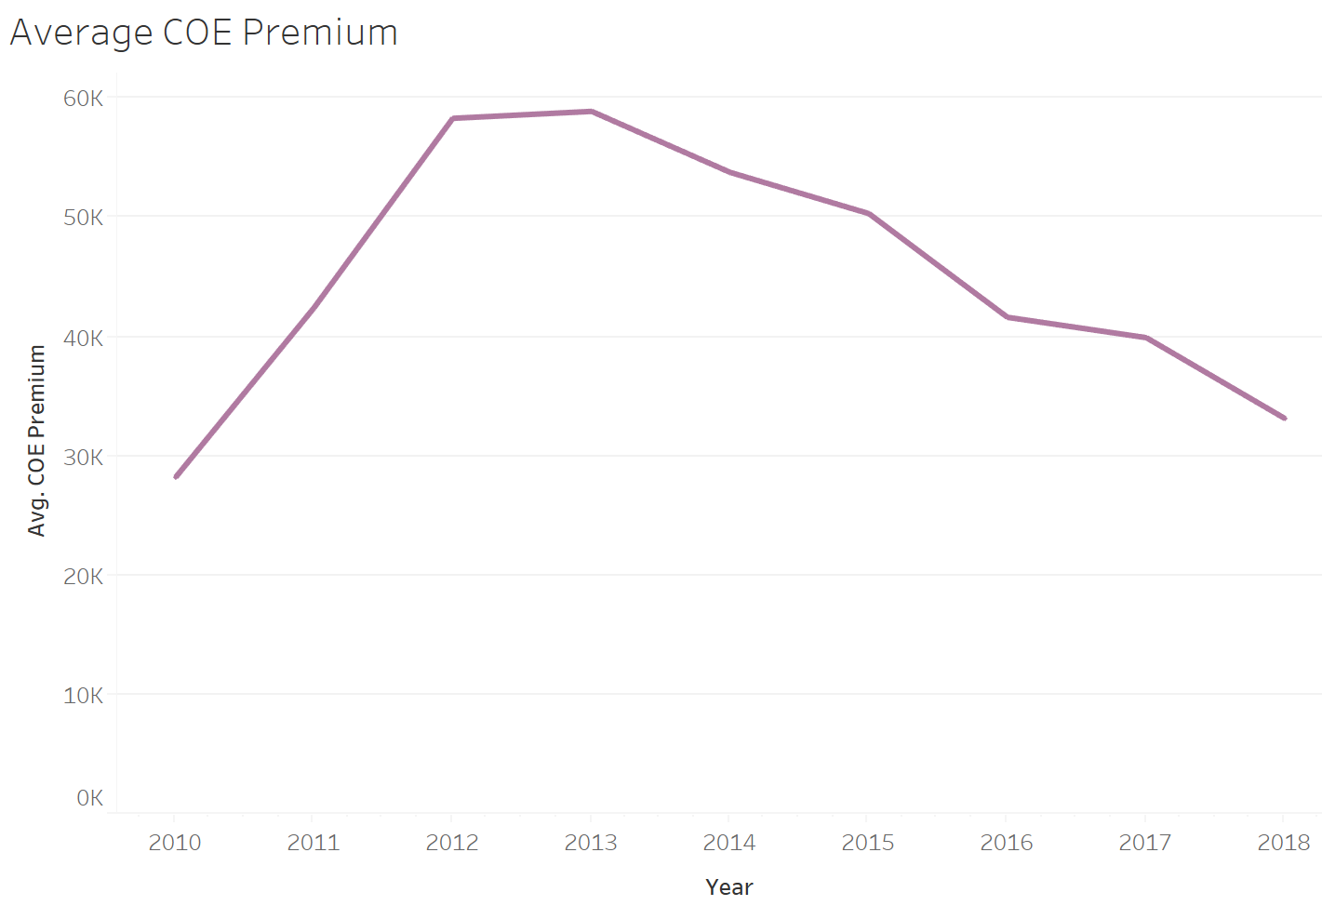
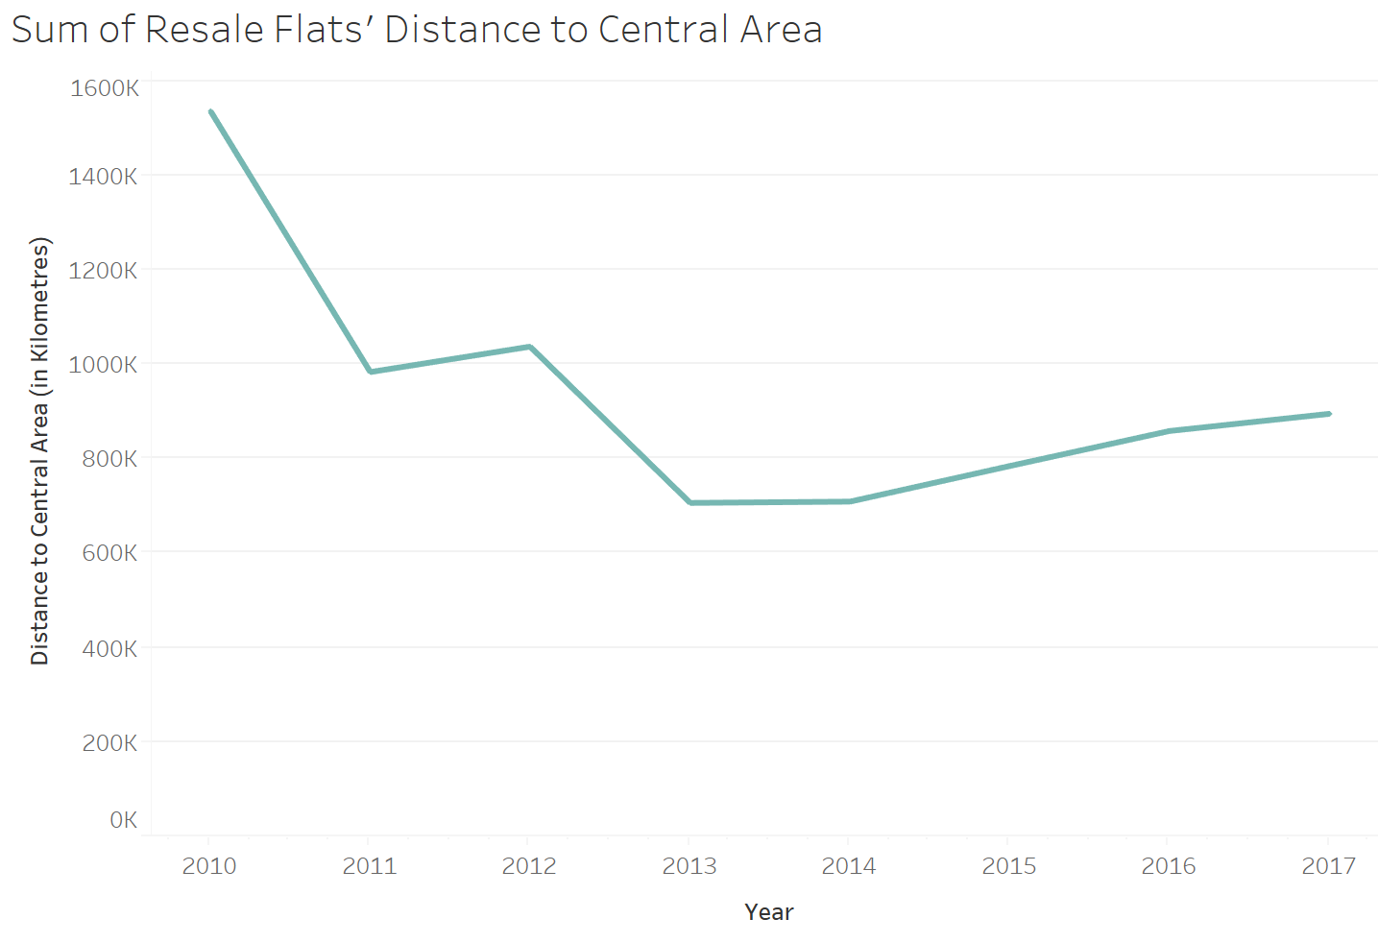
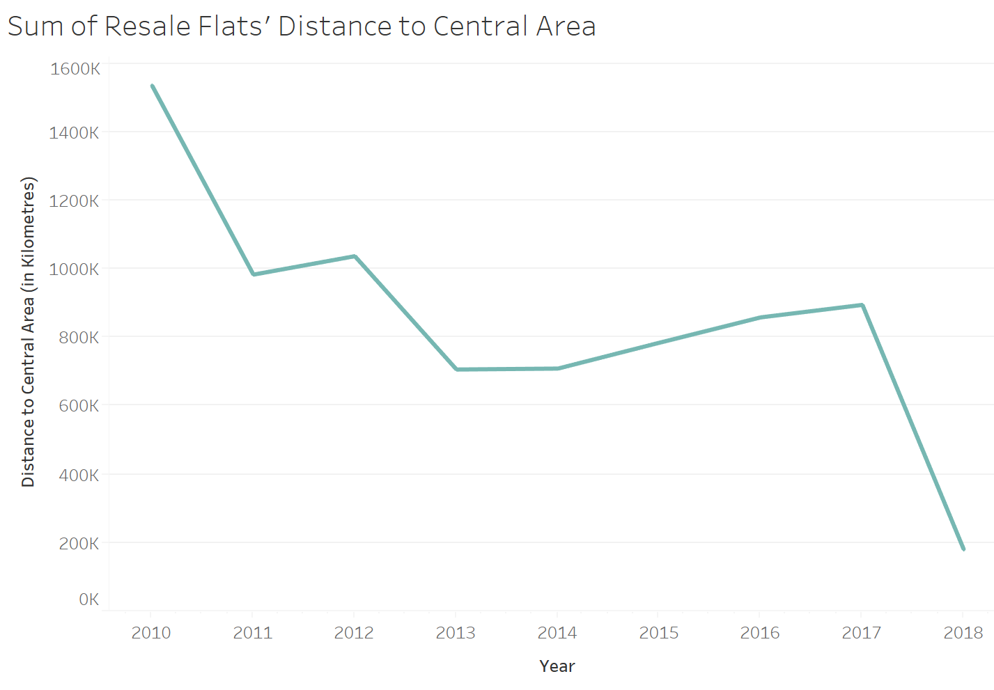
About COE Prices
COE prices are determined by the interaction of demand and supply.

Slide 29
Flats bought are further away to central area
Flats purchased are further away from central region
Lower demand for cars

Slide 30
End.
Ran out of time for 3C.

Slide 31
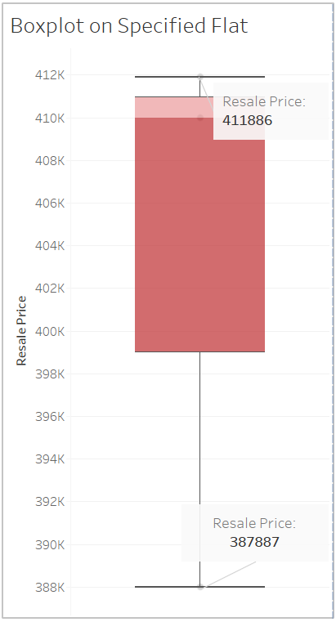
Q2B: Kena Scam?
Highly overpriced transaction
The word ‘reasonable’ is highly subjective, since the transaction consists of a willing buyer and seller
Must be good fengshui

Slide 32
Q3: Policy Analysis
Question 3C**:
The Downtown Line Stage 2 connects the Bukit Panjang heartland to the city. Have prices increased for resale flats in the towns served by this Line? You might want to use a difference-in-differences model for this task.

Slide 33
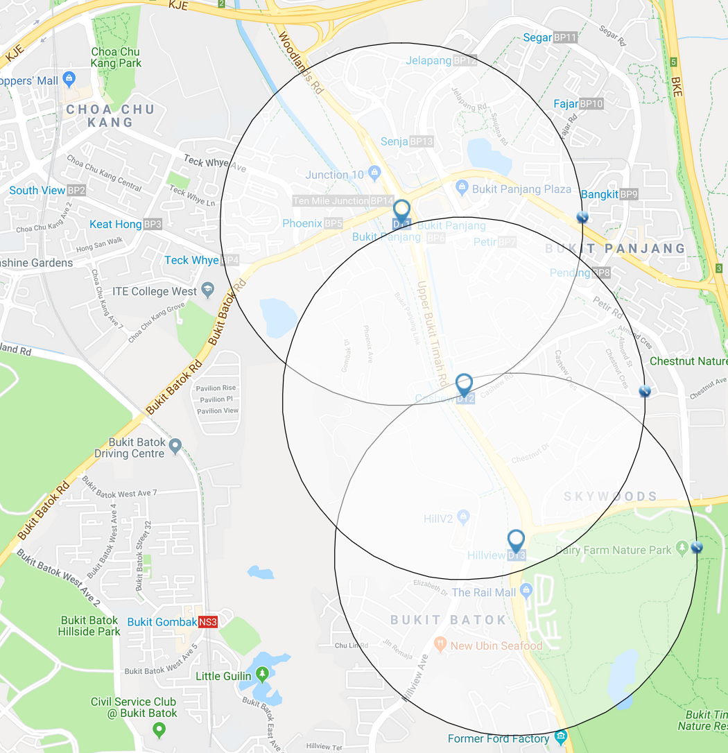
Difference-in-Differences Model
Used to estimate causal effects of the opening of Singapore's Downtown Line
Two groups: Control and Treatment
Control group: Flats outside 1km radius of any DTL station
Treatment group: Flats within 1km radius to a DTL station

Slide 34
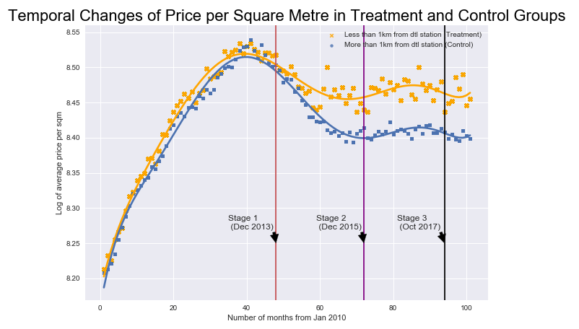
Did Opening of DTL affect Average Price per Sqm of HDB Resale Flats?

Slide 35
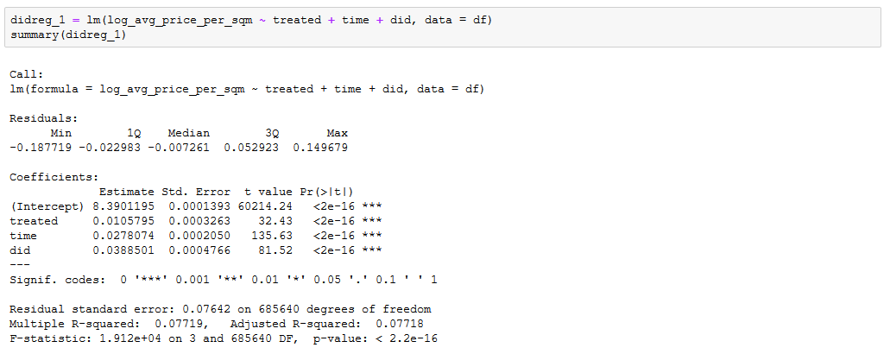
Estimating the DiD estimator
Helped to increase average price per sqm of flats near a DTL station by 3.9%.
But the average price per sqm of flats was experiencing a 2.7% growth after the opening of DTL, regardless of its proximity to a DTL station.

Slide 36
Q3: Policy Analysis
Question 3D***:
There have been comments online that people are buying flats in towns further from the city so that the cost savings can be used for a car.
Are resale prices in HDB estates in areas further away from the city (i.e. Sengkang and Punggol) impacted by Certificate of Entitlement (COE) prices for cars?

Slide 37
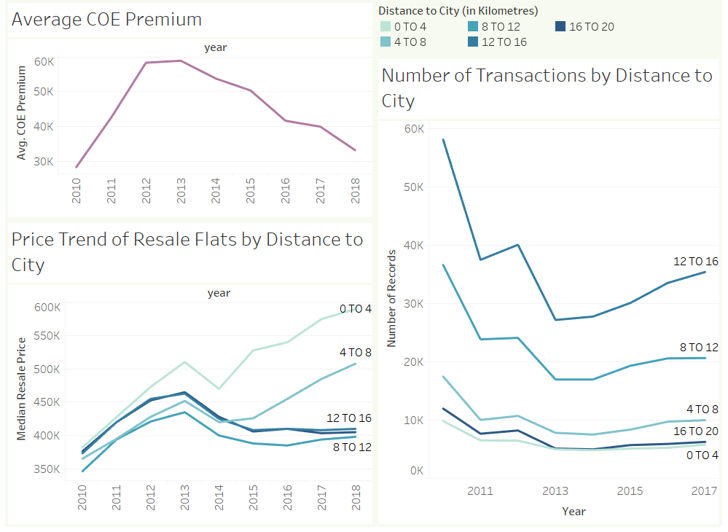
Q3D: Looking at Resale Prices and COE
Sengkang and Punggol fall in the 12 to 16 km mark.
Price trend of flats that are 8 to 20 km away from the city actually follows a similar pattern with COE prices.

Slide 38
End.
Thank you.

